Slide 1
Introduction to Bayesian Network Session 08
Course : COMP6065001 Artificial Intelligence
Effective Period : September 2023

Slide 2
Learning Outcomes
At the end of this session, students will be able to:
LO 3: Apply various techniques to an agent when acting under certainty

Slide 3
Outline
Distribution of Random Variable
Joint Probability Distribution and Marginal Probability Distribution
Independence of Random Variables
Conditional Independence

Slide 4
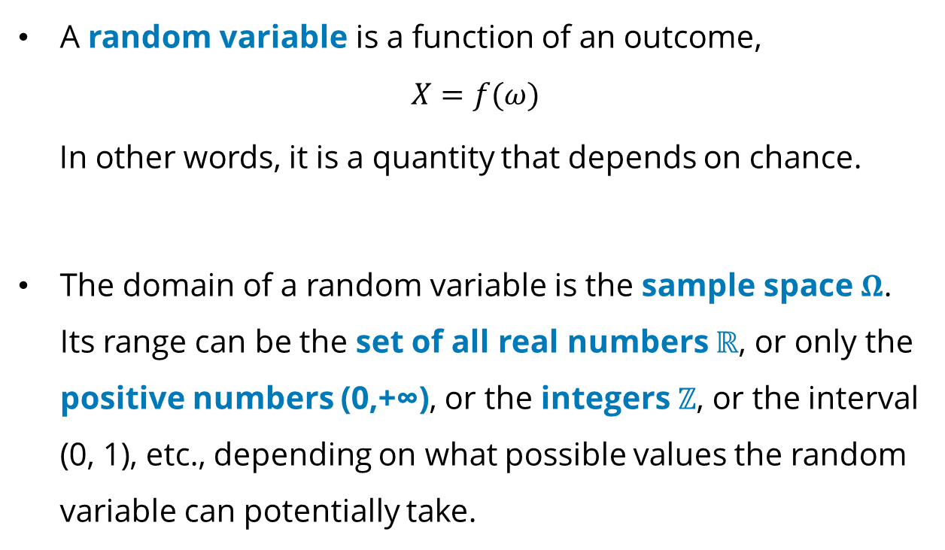
Distribution of Random Variable
A random variable is a function of an outcome,
$$X=f(ω)$$
In other words, it is a quantity that depends on chance.
The domain of a random variable is the sample space $Ω$. Its range can be the set of all real numbers $ℝ$, or only the positive numbers (0,+∞), or the integers $ℤ$, or the interval (0, 1), etc., depending on what possible values the random variable can potentially take.

Slide 5

Distribution of Random Variable
Once an experiment is completed, and the outcome $ω$ is known, the value of random variable $X(ω)$becomes determined.

Slide 6
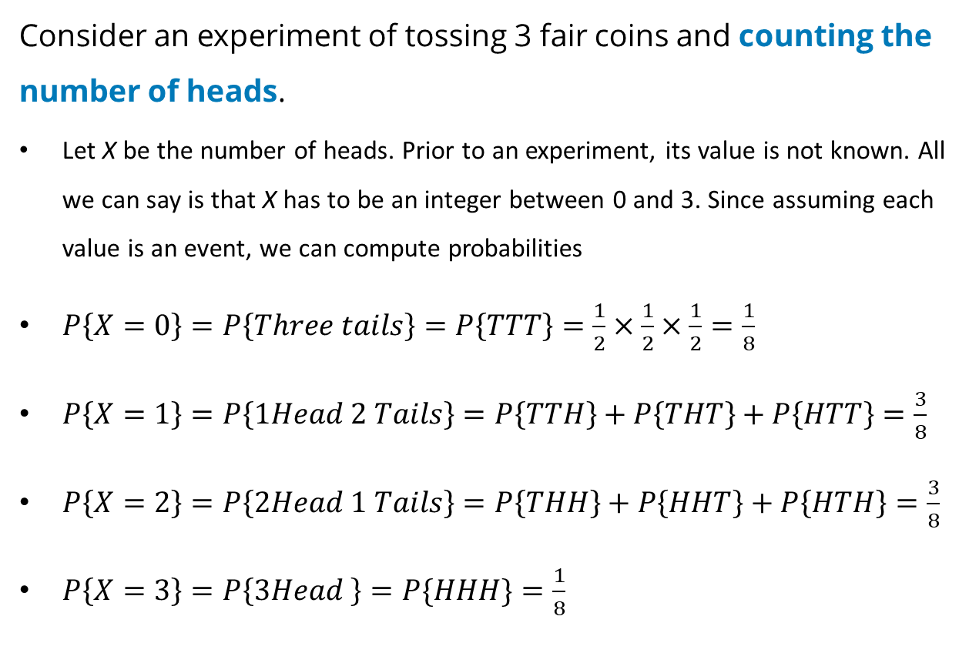
Distribution of Random Variables
Consider an experiment of tossing 3 fair coins and counting the number of heads.
Let X be the number of heads. Prior to an experiment, its value is not known. All we can say is that X has to be an integer between 0 and 3. Since assuming each value is an event, we can compute probabilities
$P\left\{X=0\right\}=P\left\{Three tails\right\}=P\left\{TTT\right\}=\frac{1}{2}×\frac{1}{2}×\frac{1}{2}=\frac{1}{8}$
$P\left\{X=1\right\}=P\left\{1Head 2 Tails\right\}=P\left\{TTH\right\}+P\left\{THT\right\}+P\left\{HTT\right\}=\frac{3}{8}$
$P\left\{X=2\right\}=P\left\{2Head 1 Tails\right\}=P\left\{THH\right\}+P\left\{HHT\right\}+P\left\{HTH\right\}=\frac{3}{8}$
$P\left\{X=3\right\}=P\left\{3Head \right\}=P\{HHH\}=\frac{1}{8}$

Slide 7
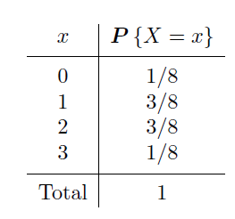
Distribution of Random Variables
Summarizing:

Slide 8
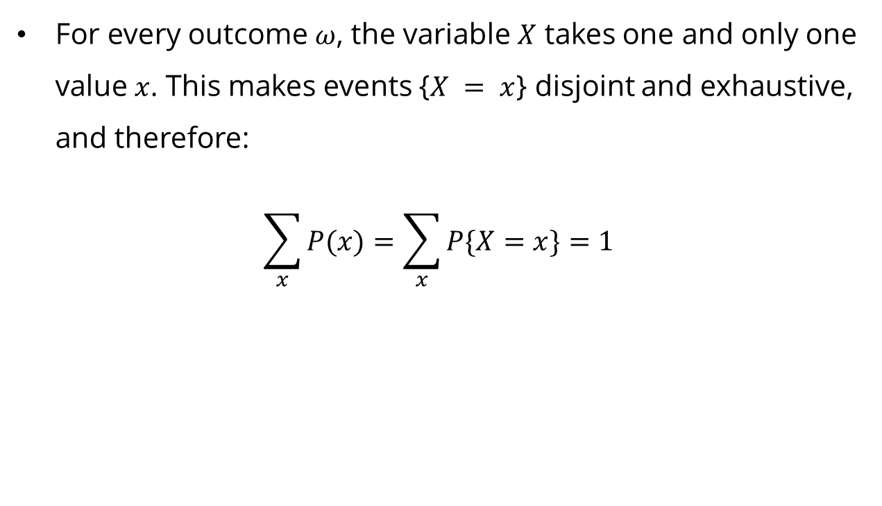
Distribution of Random Variables
For every outcome $ω$, the variable $X$ takes one and only one value $x$. This makes events {$X = x$} disjoint and exhaustive, and therefore:
$$\sum_{x}{P(x)}=\sum_{x}{P\{X=x\}}=1$$

Slide 9
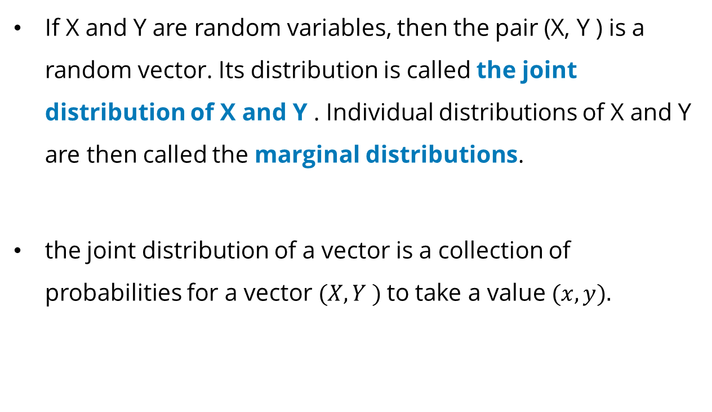
Joint Distribution and Marginal Distribution
If X and Y are random variables, then the pair (X, Y ) is a random vector. Its distribution is called the joint distribution of X and Y . Individual distributions of X and Y are then called the marginal distributions.
the joint distribution of a vector is a collection of probabilities for a vector $(X, Y )$to take a value $(x, y).$

Slide 10
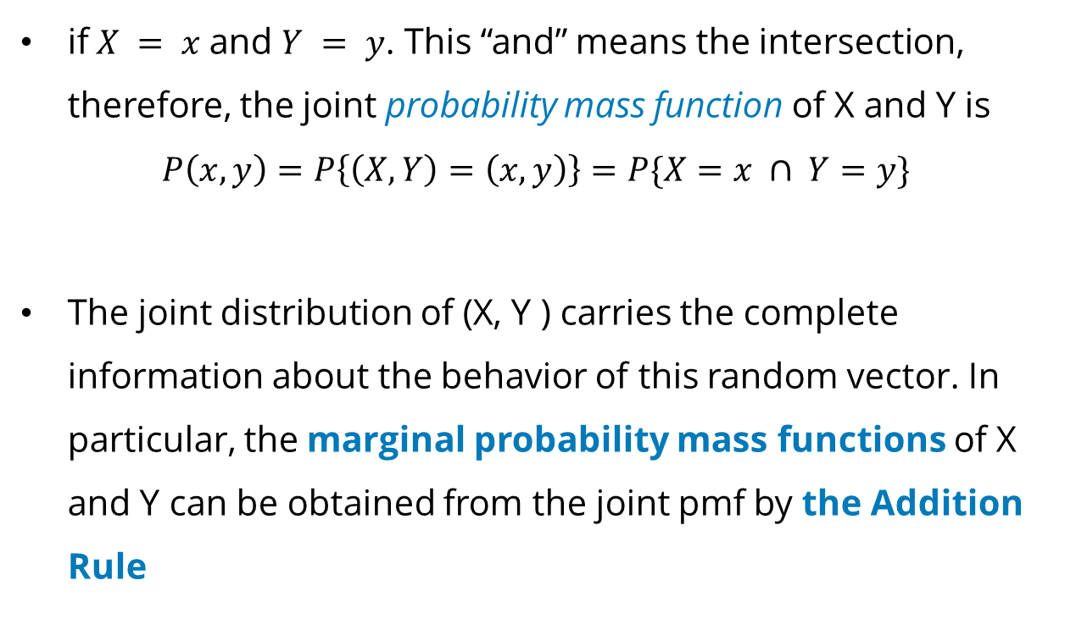
Joint Distribution and Marginal Distribution
if$X = x$and $Y = y$. This “and” means the intersection, therefore, the joint probability mass function of X and Y is
$$P\left(x,y\right)=P\left\{\left(X,Y\right)=\left(x,y\right)\right\}=P\{X=x ∩ Y=y\}$$
The joint distribution of (X, Y ) carries the complete information about the behavior of this random vector. In particular, the marginal probability mass functions of X and Y can be obtained from the joint pmf by the Addition Rule

Slide 11
Example Joint Distribution and Marginal Distribution
Let's consider a simple scenario where we have two events: flipping a fair coin and rolling a fair six-sided die. calculate the probability of getting a heads and a six on the die roll.

Slide 12
Example Joint Distribution and Marginal Distribution
Joint Distribution
 | Die=1 | Die=2 | Die=3 | Die=4 | Die=5 | Die=6
Coin=H | 1/12 | 1/12 | 1/12 | 1/12 | 1/12 | 1/12
Coin=T | 1/12 | 1/12 | 1/12 | 1/12 | 1/12 | 1/12

Slide 13
Example Joint Distribution and Marginal Distribution
Marginal probability of Coin
 | Die=1 | Die=2 | Die=3 | Die=4 | Die=5 | Die=6
Coin=H | 1/12 | 1/12 | 1/12 | 1/12 | 1/12 | 1/12
Coin=T | 1/12 | 1/12 | 1/12 | 1/12 | 1/12 | 1/12
Marginal | 1/6 | 1/6 | 1/6 | 1/6 | 1/6 | 1/6

Slide 14
Example Joint Distribution and Marginal Distribution
Marginal Probability of Die
 | Die=1 | Die=2 | Die=3 | Die=4 | Die=5 | Die=6 | Marginal
Coin=H | 1/12 | 1/12 | 1/12 | 1/12 | 1/12 | 1/12 | 1/2
Coin=T | 1/12 | 1/12 | 1/12 | 1/12 | 1/12 | 1/12 | 1/2

Slide 15
Example Joint Distribution and Marginal Distribution
we want to calculate the probability of getting a heads and a six on the die roll. We can simply look up the probability from the joint probability distribution table:
 | Die=1 | Die=2 | Die=3 | Die=4 | Die=5 | Die=6
Coin=H | 1/12 | 1/12 | 1/12 | 1/12 | 1/12 | 1/12
Coin=T | 1/12 | 1/12 | 1/12 | 1/12 | 1/12 | 1/12

Slide 16
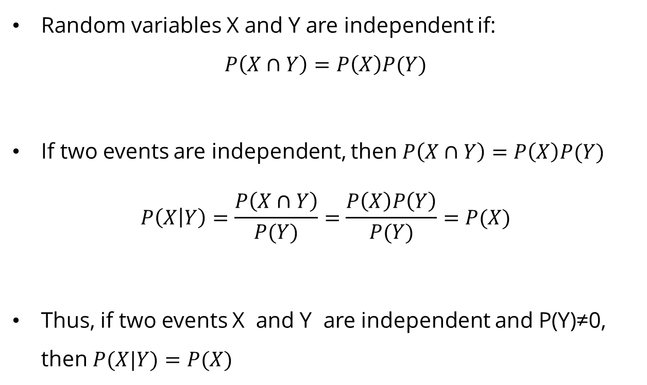
Independence
Random variables X and Y are independent if:
$$P\left(X∩Y\right)=P\left(X\right)P(Y)$$
If two events are independent, then $P\left(X∩Y\right)=P\left(X\right)P(Y)$
$$P\left(X | Y\right)=\frac{P\left(X∩Y\right)}{P(Y)}=\frac{P\left(X\right)P\left(Y\right)}{P(Y)}=P(X)$$
Thus, if two events X and Y are independent and P(Y)≠0, then $P(X|Y)=P(X)$

Slide 17
Example of Independence
I pick a random number from {1,2,3,⋯,10} , and call it N. Suppose that all outcomes are equally likely. Let A be the event that N is less than 7, and let B be the event that N is an even number. Are A and B independent?

Slide 18
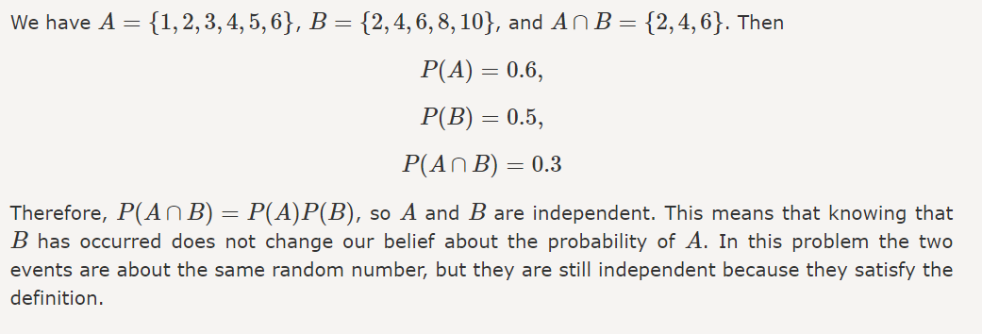
Example of Independence

Slide 19
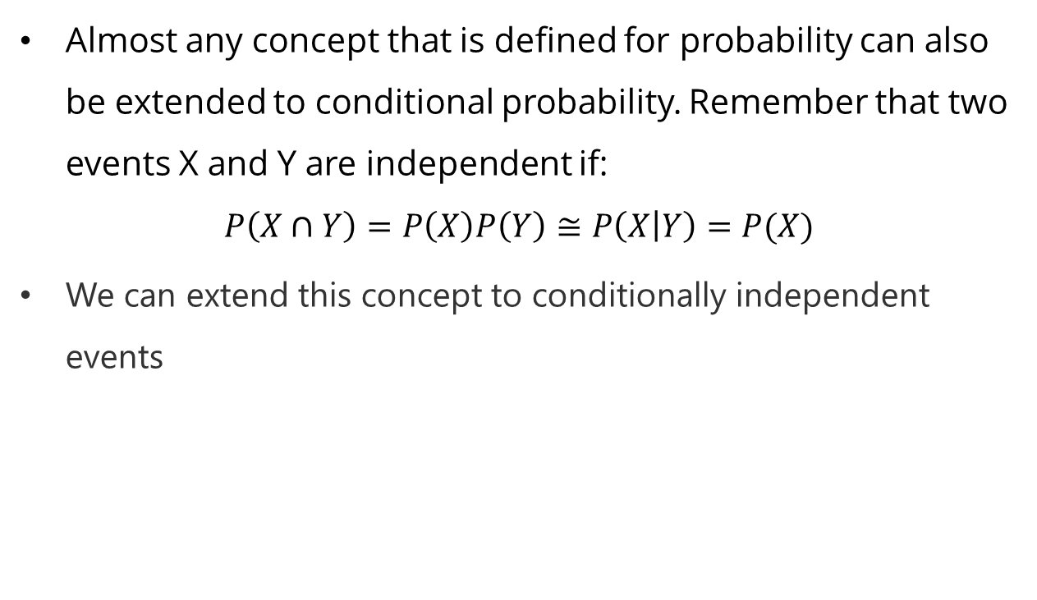
Conditional Independence
Almost any concept that is defined for probability can also be extended to conditional probability. Remember that two events X and Y are independent if:
$$P\left(X∩Y\right)=P\left(X\right)P\left(Y\right)≅P\left(X | Y\right)=P(X)$$
We can extend this concept to conditionally independent events

Slide 20
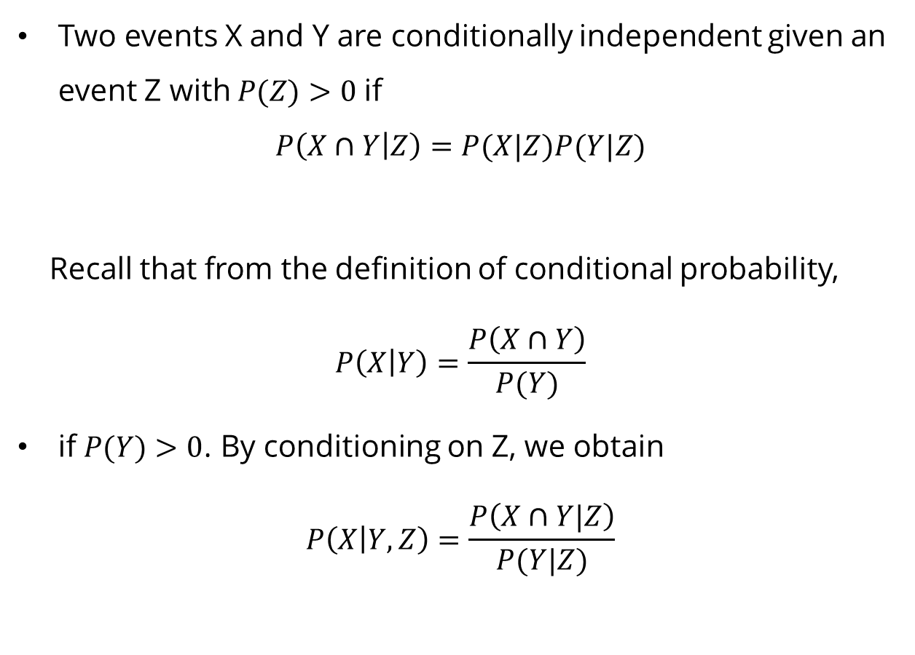
Conditional Independence
Two events X and Y are conditionally independent given an event Z with $P(Z)>0$if
$$P\left(X∩Y | Z\right)=P(X|Z)P(Y|Z)$$
Recall that from the definition of conditional probability,
$$P\left(X | Y\right)=\frac{P\left(X∩Y\right)}{P(Y)}$$
if $P(Y)>0$. By conditioning on Z, we obtain
$$P\left(X | Y,Z\right)=\frac{P\left(X∩Y|Z\right)}{P(Y|Z)}$$

Slide 21

Conditional Independence
If $P(Y|Z),P(Z)≠0$. If $X$ and $Y$ are conditionally independent given $Z$, we obtain
$$P\left(X | Y,Z\right)=\frac{P\left(X∩Y|Z\right)}{P(Y|Z)}=\frac{P(X|Z)P(Y|Z) }{P(Y|Z)}$$
$$P\left(X | Y,Z\right)=P(X|Z)$$

Slide 22
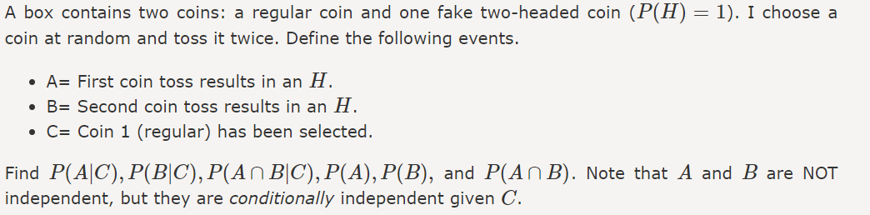
Example of Conditional Independence

Slide 23
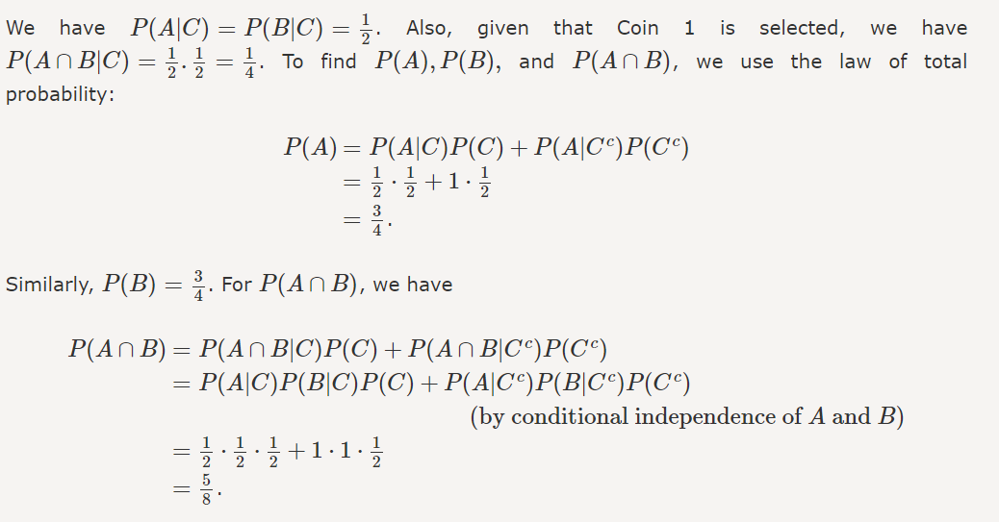
Example of Conditional Independence

Slide 24
Exercise

Slide 25
Exercise
Suppose we are studying the incidence of heart disease in a population of individuals, and we are interested in whether gender and smoking status are related to the incidence of heart disease. We have collected data on 1000 individuals, and we know their gender, smoking status, and whether or not they have heart disease. Find whether smoking status and gender are conditionally independent given the presence or absence of heart disease,

Slide 26
Exercise
Here the data contingency to help you for this exercise:
 | Non-Smoker | Smoker
Male | 300 | 200
Female | 250 | 250

Slide 27
References
Stuart Russell, Peter Norvig. 2020. Artificial Intelligence : A Modern Approach. Pearson Education. New Jersey.
Michael Baron. Probability and Statistics for Computer Science 3rd Edition. CRC Press.
https://www.probabilitycourse.com/chapter1/1_4_1_independence.php

